Slide 1

Diabetes Prediction using Logistic Regression

Slide 2
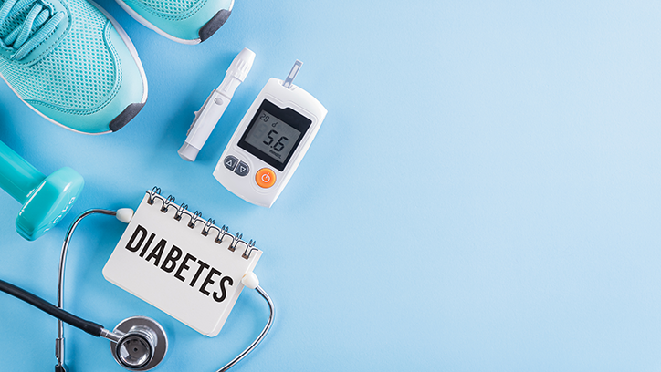
Team Working On this
Krishna Vamsi Nadh Arikatla
Deepika Linga
Saranya DegaPudi
Jaswanth Survi

Slide 3
The Problem
Problem #1 A person developing diabetes based on various factors such as age, weight, blood pressure, family history, and lifestyle choices.
Problem #2 It can also be based on the severity of the condition, such as well-controlled diabetes, poorly controlled diabetes, and diabetes with complications.
Problem #3 To build a predictive model that can help healthcare professionals identify individuals who are at high risk of developing diabetes
01
02
03

Slide 4
The Solution
Solution #1
Solution #2
Solution #3
Providing appropriate medical intervention, such as adjusting medication, dietary modifications, or referral to a specialist
Using Machine Learning we can predict early diabetes.
To prevent or manage the condition, such as lifestyle modifications, medication, or regular monitoring of blood glucose levels.
01
02
03

Slide 5
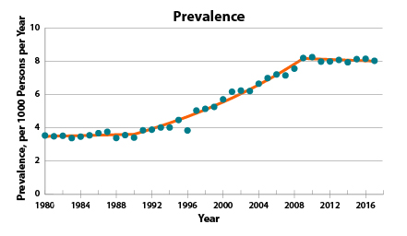
People Diagnosed with Diabetes

Slide 6
Business model / Plan
Data Collection
Data Visualization
Apply Machine Learning model
Split Train(80%) Test(20%) dataset
Evaluate Results
Classification
Built a model Using Logistic Regression on the basis of different factors such as age, weight, Blood Pressure, etc.

Slide 7
Technology/expertise
Exploratory Data Analysis
Diabetes Prediction using Logistic Regression
Feature Extraction
Models

Slide 8
Exploratory Data Analysis:
Set the goal: Define the goal of the analysis, such as identifying diabetes in a person.
Read the data: Import the dataset and related libraries.
Understand the data: Spend enough time understanding the data. Try to gather as much information as possible about the data.
Cleanse the data: Real-world data is never perfect, so it’s essential to clean the data before analysis.
Analyze the data: Perform bivariate analysis to identify relationships between variables.

Slide 9
Feature Extraction:
Feature extraction is a crucial step in machine learning, especially in the case of medical data.
Models:
The project aims to develop a model that can predict diabetes with high accuracy and can be used as a tool for early detection of diabetes.Therefore, for this classification of task, multiple techniques used in Feature Engineering, also trained a model based on Logistic Regression to Predict wether a person has diabetes or not.

Slide 10
Why We are Better?
Data Extraction
Classification & Evaluation
Logistic Regression

Slide 11
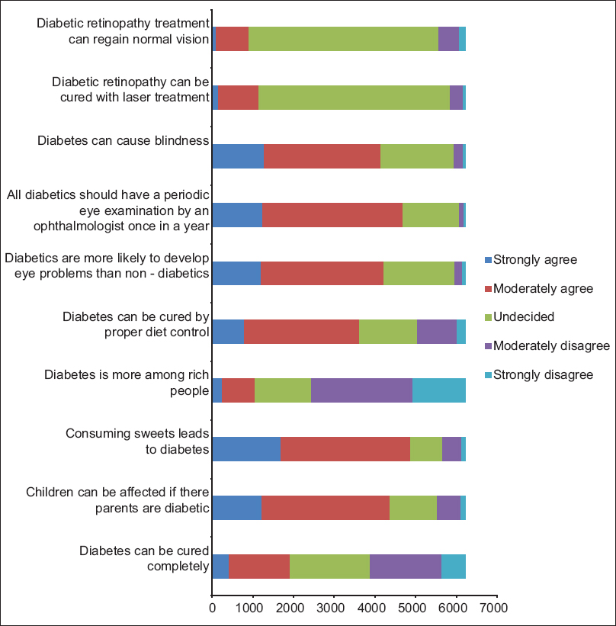
Information About Diabetes among People

Slide 12
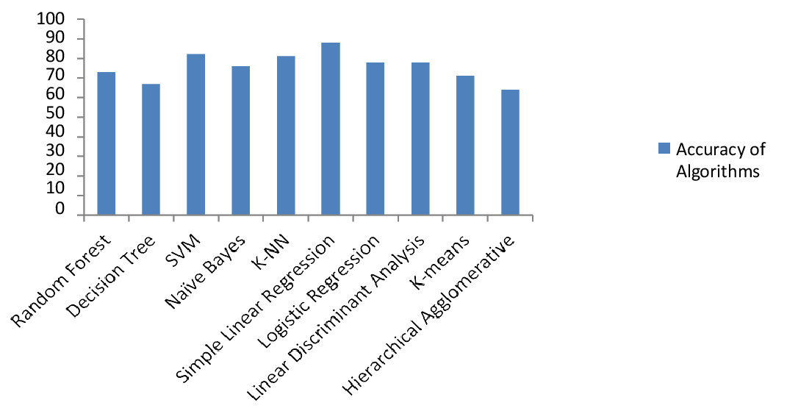
Comparision of Accuracy Of Various Algorithms

Slide 13
Roadmap, metrics milestones
Extract Better Data
Data Collection and cleaning
Data Analysis
The model is trained using a variety of classification algorithms. The most accurately predicted classifier is Logistic Regression
Collect clean data from public hospital domains. Data mining techniques contribute to health care decisions for accurate disease diagnosis and treatment, reducing the workload of experts. Early diabetes prediction will result in improved treatment
There are different types of data collection strategies for diabetes programs, and they may use a range of data collection strategies2. Data cleaning refers to the process of removing invalid data points from a dataset. It plays a significant part in building a model

Slide 14

Thank you

